Slide 1
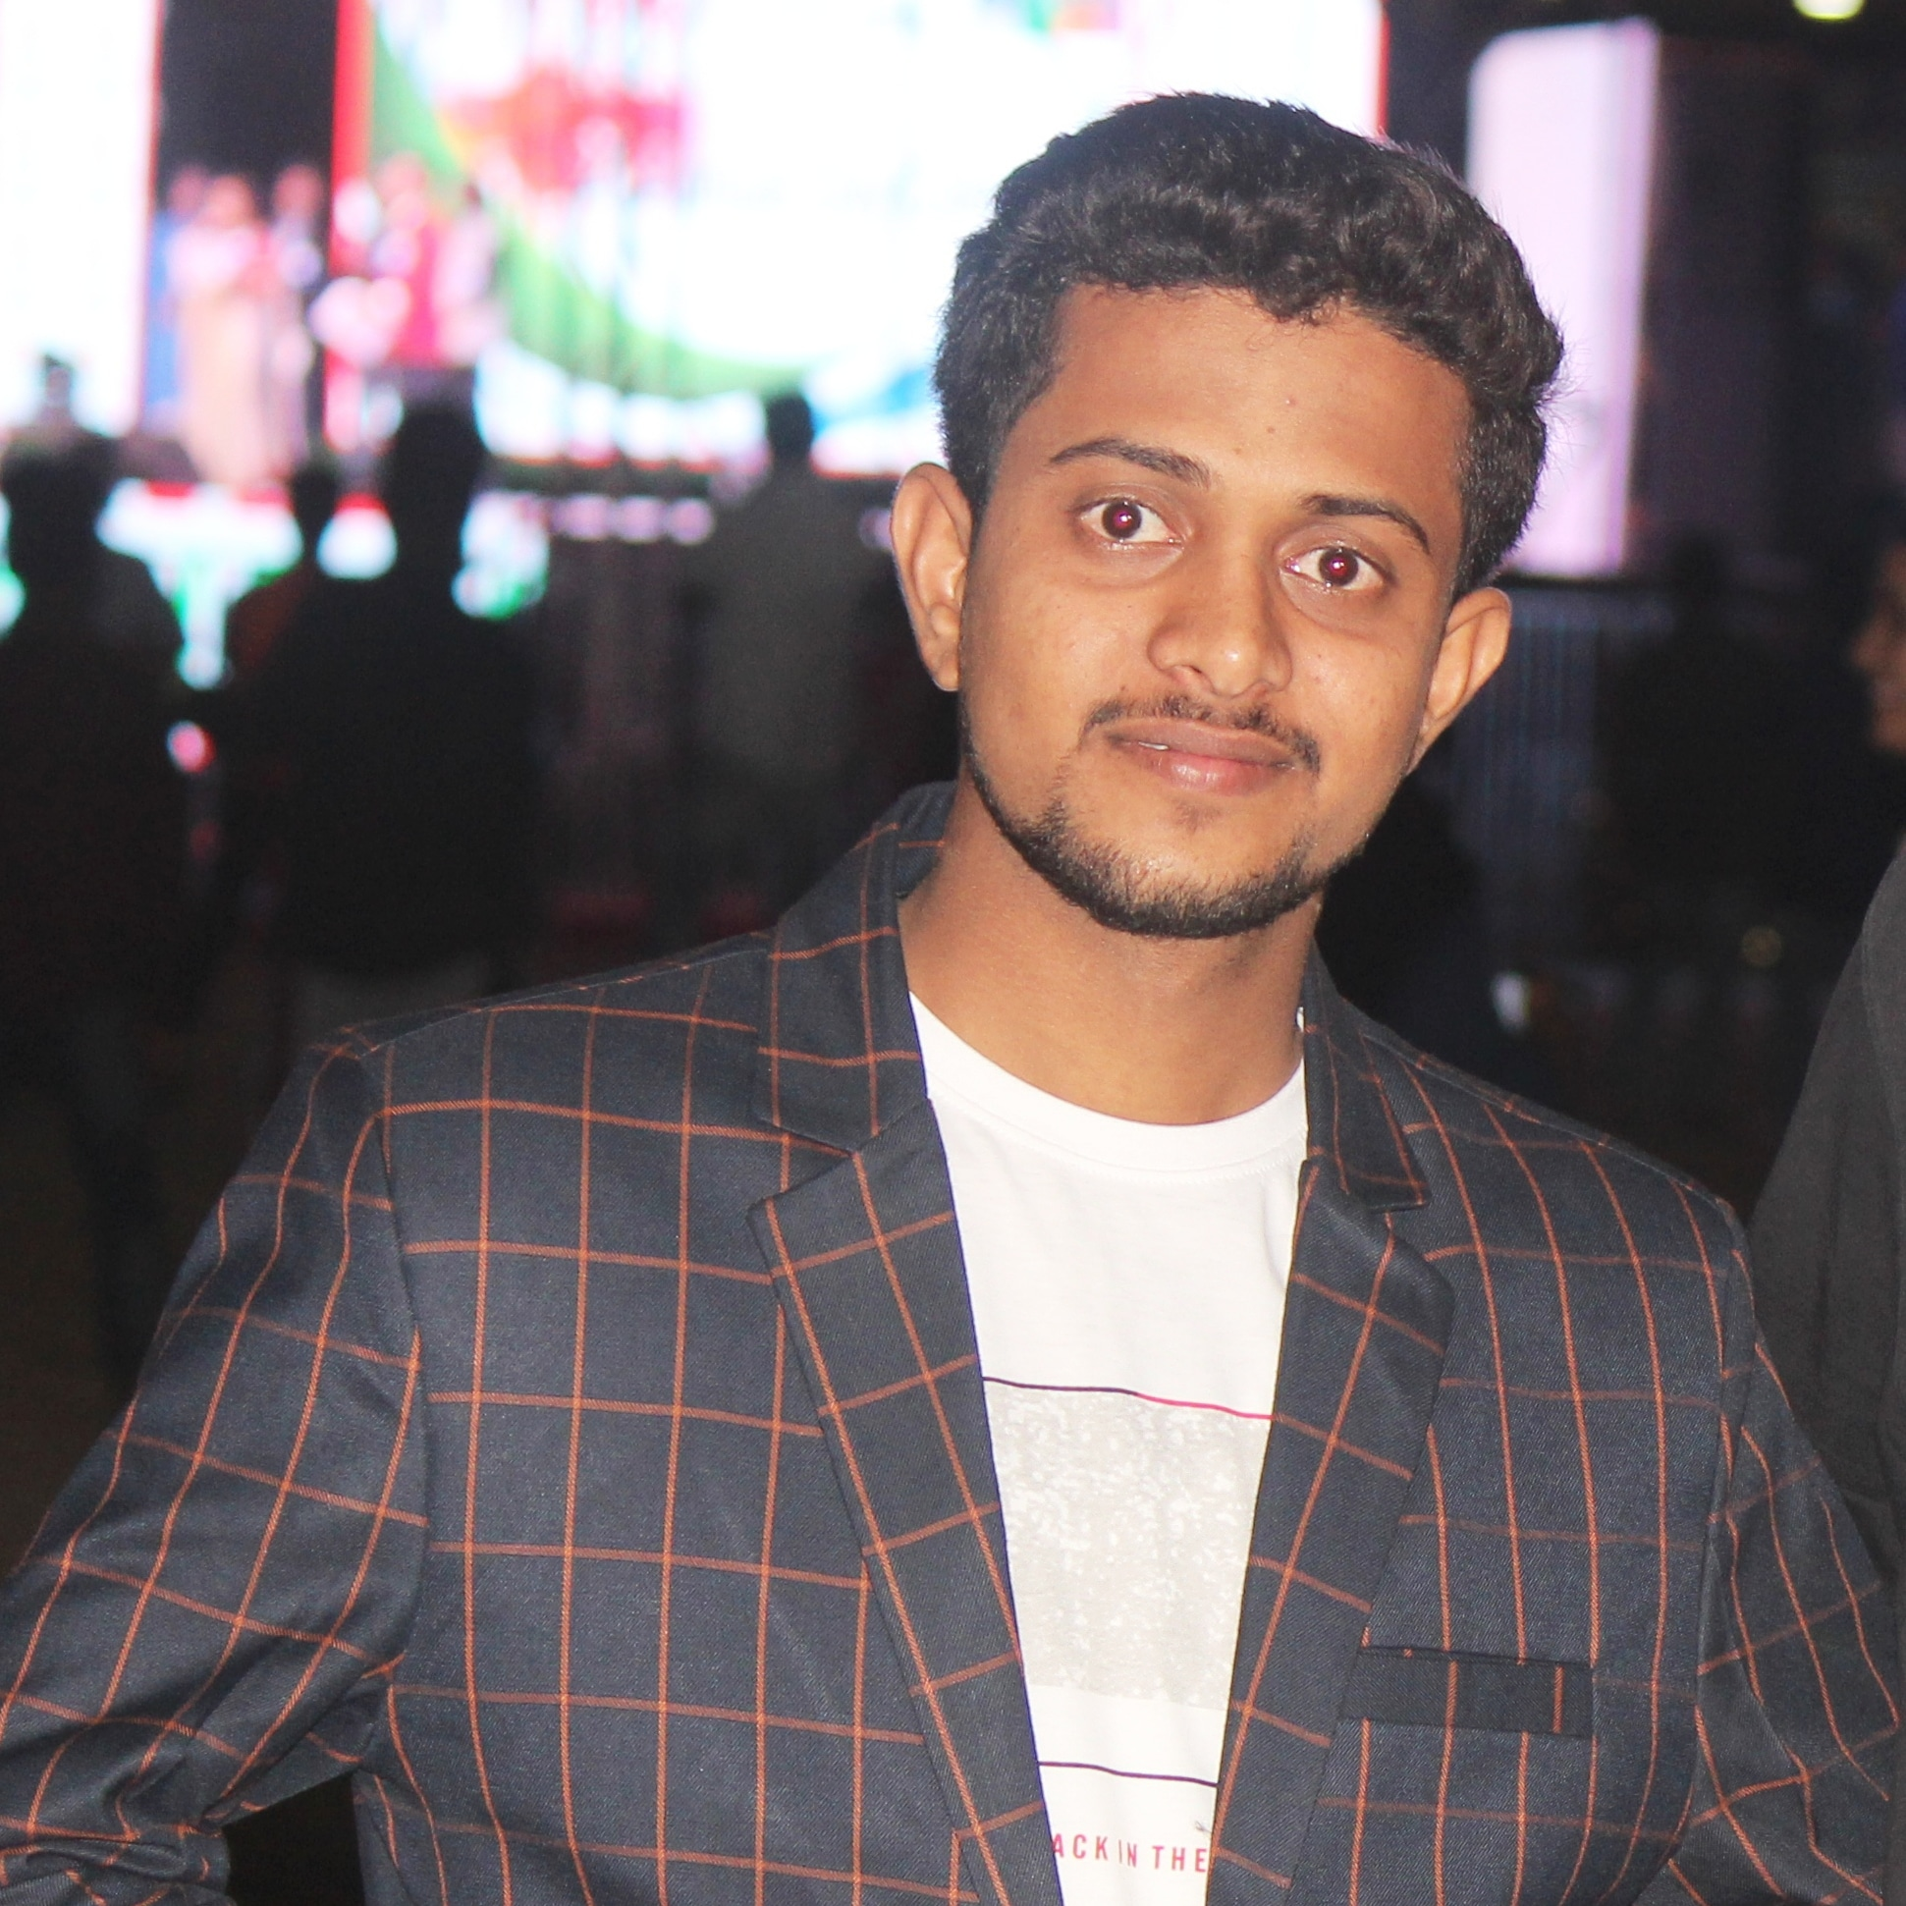



Mohammed RehanUddin
Analyst/Full Stack Developer (Angular)
Bachelor of Technology Electronics and Communication : 2017 - 2021
Skills
Bangalore
JAVA Spring Boot Spring MVC Spring Cloud Full Stack Spring Angular MongoDB Database No SQL database – MongoDB SQL database -MySQL Web Technologies HTML5 CSS3 Javascript Tools GitHub Postman Docker Additional Details Team player Communication Skills Team management
mohammed-rehan.uddin@capgemini.com
+91 8328144585
A4
Full Stack Developer
Hands on experience in creating microservices with Java ,Spring boot,Spring security,Spring Cloud API Gateway,Eureka server and Swagger.
Hands on experience in creating Single Page Web Application in Angular along with Authentication using HTML,CSS,Java Script.
Eager to improve myself by learning new technology and excited to work as a team member.
Pakinstan Railway Reservation System Application
Completed end to end case study of Railway Reservation System Application along with JWT authentication, Swagger ,Eureka server and API gateway . Responsive UI with HTML,CSS and Angular used for user interface.
Created Admin Train Details and Booking Ticket microservices as a back end using spring boot and connected two microservices via Eureka Server as discovery server . used Mongodb Atlas for database and Postman is used for method calling.
Implimented Front end with Angular 12 using HTML,CSS and Java Script
Check out my work on GitHub & Video Profile
https://github.com/rehanuddin8-github/onepager.git
https://youtu.be/vsgnXZNinl8

